Slide 1
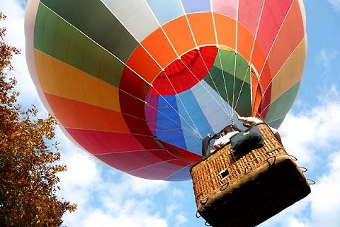
PORTABLE EMERGENCY EQUIPMENT

Slide 2

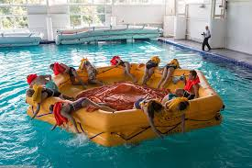
* PORTABLE EMERGENCY EQUIPMENT
Stationary;
Portable.
Слайд 0.

Slide 3
Stationary emergency equipment
Стационарное Аварийное оборудование.
For each specific aircraft consists of the following:
flight Deck and Passenger cabin emergency oxygen system;
Emergency lighting (including emergency path lighting);
Inflatable slide and inflatable sliderafts;
Smoke detectors;
Self-activated stationary fire-extinguishers in lavatories, Engine, Gear, Cargo compartment;
Emergency exits;
Emergency escape ropes;
Passenger and crew seat belts;
Floatation means;
Crew communication and alerting system.

Slide 4
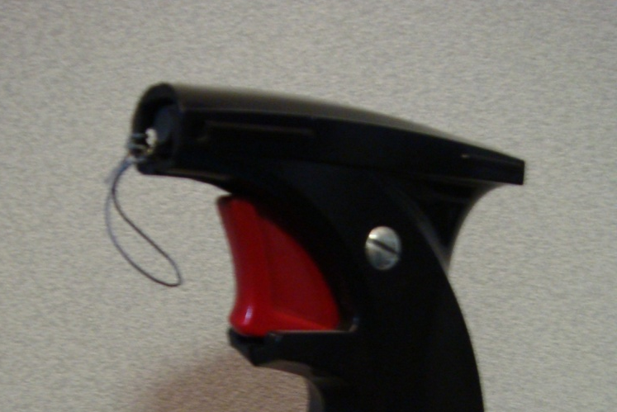
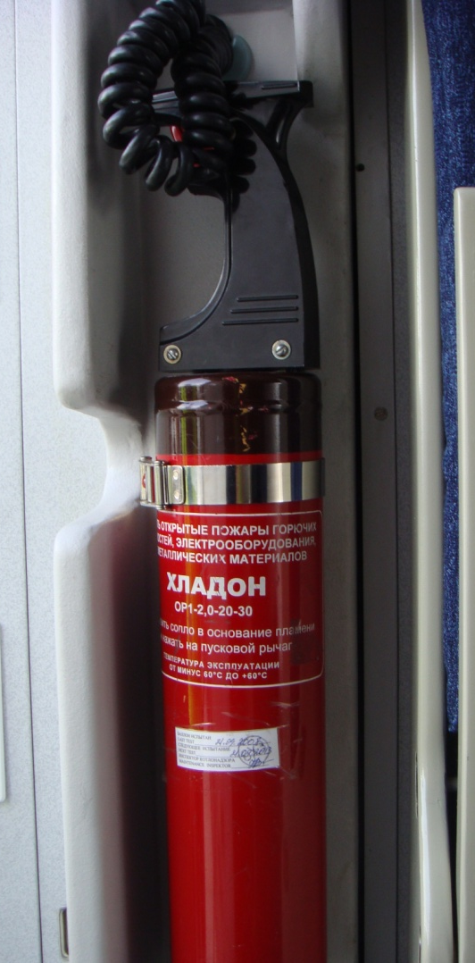
*Fire extinguisher.
Hladon fire extinguisher.
ОР 1 - 2,0 (1.0)– 20 - 30
Pre-flight check.
Available on board;
Secured;
Wire seal intact;
Safety pin in place;
Expiry date.
Technical characteristics.
- Color Balloon - red with burgundy rim at the base of the handle, black handle;
range – up to 3 m;
duration – up to 10 sec.
How to use:
Hold the cylinder by it’s handle in the upright position;
Pull out the safety pin;
Aim at the base of fire;
Check operation;
Squeeze the handle;
Use sweeping motions.
Слайд 1.
Notes:
Раздаточный слайд

Slide 5
*Crash axe.
Pre-flight check:
available on board;
secured.
Предполетная проверка:
Наличие на борту;
Закреплен.
Note:
A fire-fighting crash is carried on the flight deck of all aircraft.
The crash axe has a blade, hook, rubber covered handle to protect against electrical shocks.
The crash axe should be used during fire fighting to assist in removing panels or partitions enabling the base of fire to be exposed.
Слайд 3.
Notes:
Раздаточный слайд

Slide 6
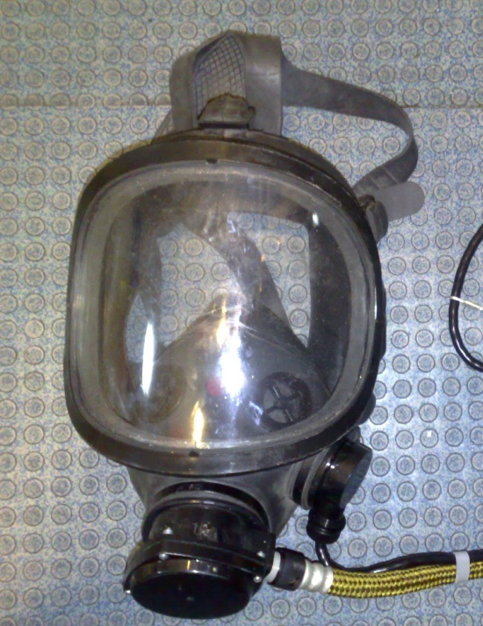
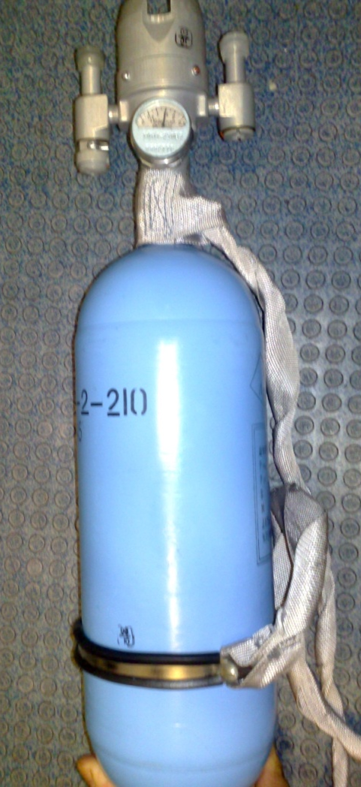
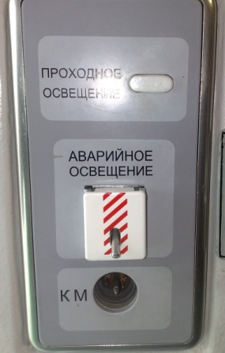
ПОДКЛЮЧЕНИЕ МАСКИ К БАЛОНУ И К ГНЕЗДУ «КМ»
При работе с кислородом, соблюдайте правила безопасности!

Slide 7
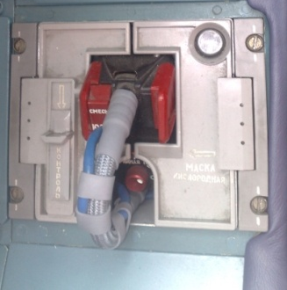
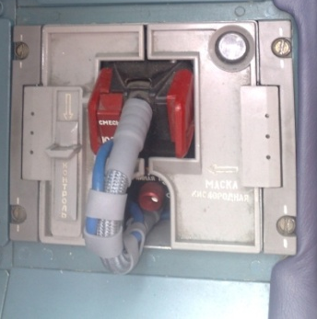

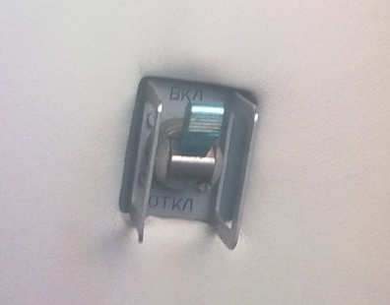
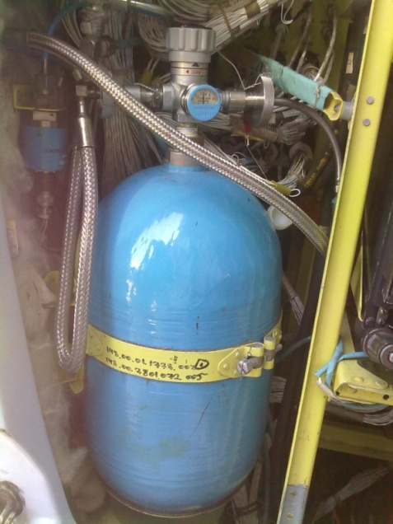
РАБОТА СТАЦИОНАРНОЙ КИСЛОРОДНОЙ СИСТЕМЫ ДЛЯ ЭКИПАЖА
БКО – 5К
Блок кислородного оборудования
РД - 1
УВЦ -10-150

Slide 8
Использование кислородных масок в кабине пилотов:
Нажать на 2 красных клапана, извлечь маску,
Переключателем “Normal/100%” выбираем режим подачи кислорода, Смешанный режим, 100% кислород;
Индикатор “кошачий глаз” открывается, когда О2 поступает в маску;
Переключатель “TEST/RESET”, для контроля работоспособности прибора;
поворотом кнопки, переключаем прибор в положение непрерывной подачи О2.

Slide 9
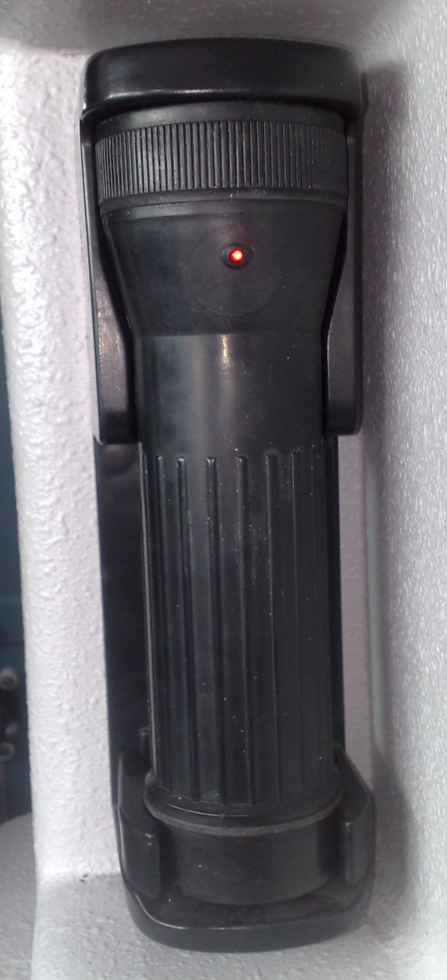
*Emergency flashlight.
Pre-flight check:
Available on board;
Securely ;
An alarm lamp is steady lights.
How to use:
- Pull the flashlight from the bracket and turn switcher to ON position.
Note:
Emergency use only;
- When flashlight in store position, it’s recharge automatically.
Technical characteristics:
Duration – up to 6 hours.
Слайд 8.

Slide 10

* Portable oxygen bottle БКП-2-210
Pre-flight check:
The presence on board according to the required number of circuits ACO;
Pressure gauge needle 1.5 kg / cm2
Position oxygen supply lever in the "OFF";
Availability plugs on the outputs (s piece.)
The presence of a belt for attaching the balloon.
The presence of masks INC - 1T - 2 pcs.
Safety precautions.
- Always check nobody smokes in range 3 rows fore and aft;
before donning the mask make sure face is free of make-up and grease;
- In case of asthma use «2» outlet;
- Report to the Captain;
- Stay with the passenger;
- Do not discharge oxygen bottle below 10 kg/ sm³;
- Additionally, supplemental or therapeutic oxygen provides a low supplemental oxygen flow in a smoke-laden atmosphere. A smoke proof set should be used.
Слайд 9.
Notes:
Раздаточный слайд

Slide 11
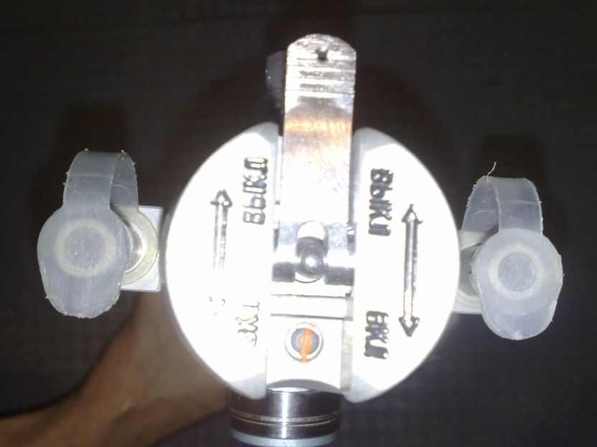
*How to use:
Connect and secure the mask tubing to the necessary outlet (4 or 2);
Turn switcher in on position;
Check the flow of oxygen (squeeze bag, when applicable, flow indicator turns green when oxygen flows);
Check oxygen flow has no smell;
Put the mask on the passenger;
Secure the mask by adjusting the elastic strap;
To stop using oxygen bottle put the mask off, turn switcher in OFF position, disconnect the mask tubing.
Слайд 11.
Notes:
Раздаточный слайд

Slide 12
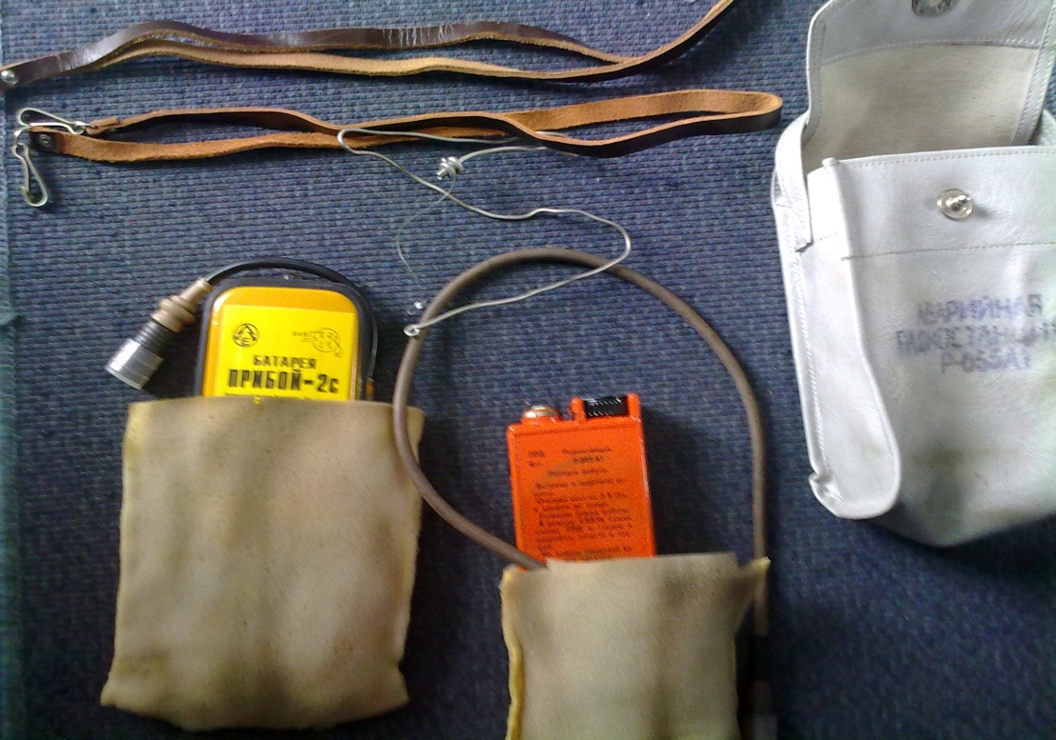
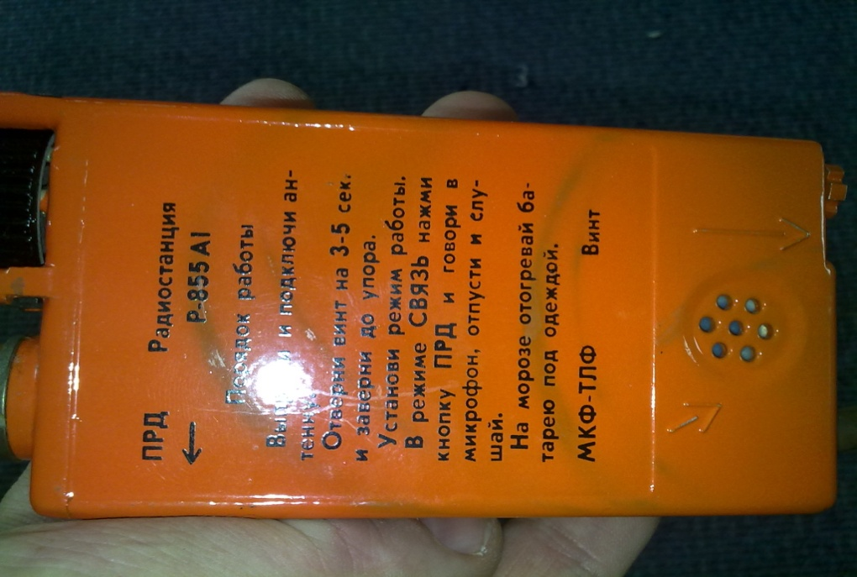
Note:
The PLB consists of a beacon and battery.
It transmits a 121.5 MHz and 243 MHz signal to facilitate the final approach of the search and rescue teams.
Excessive use of the transmit facility reduces the life of the battery and the ability of beacon to transmit, thus, it is recommended that the transmit facility is only used to respond to incoming messages or when a rescue team is seen or heard.
**Technical characteristics:
color – yellow;
frequencies –121.5 mhz, 243 mhz;
activation – manual;
speech facility;
autonomy – more then 48 hrs;
waterproof – 10 m.
Слайд 18.
Notes:
Раздаточный слайд

Slide 13
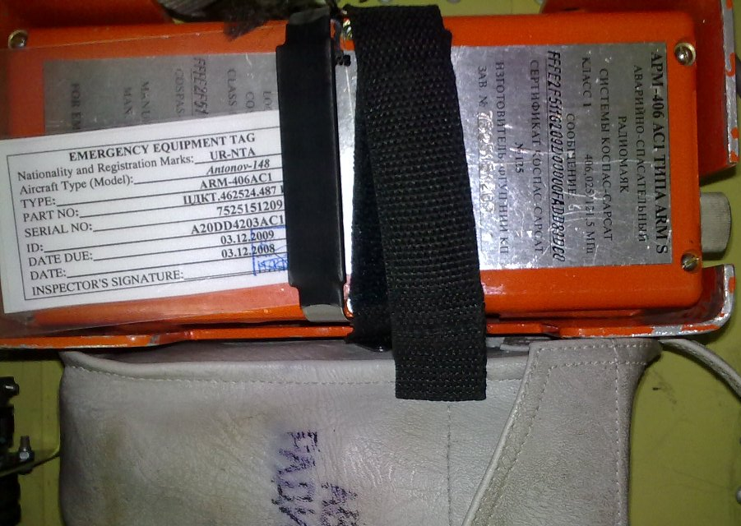
* Emergency radio beacon APM-406 АС1
Technical characteristics:
color – red;
frequencies – 406.25 mhz, 121.5 mhz,
activation – manual;
autonomy – more then 48 hrs;
      Preflight check:
Available on board;
Слайд 19.
Notes:
Раздаточный слайд

Slide 14
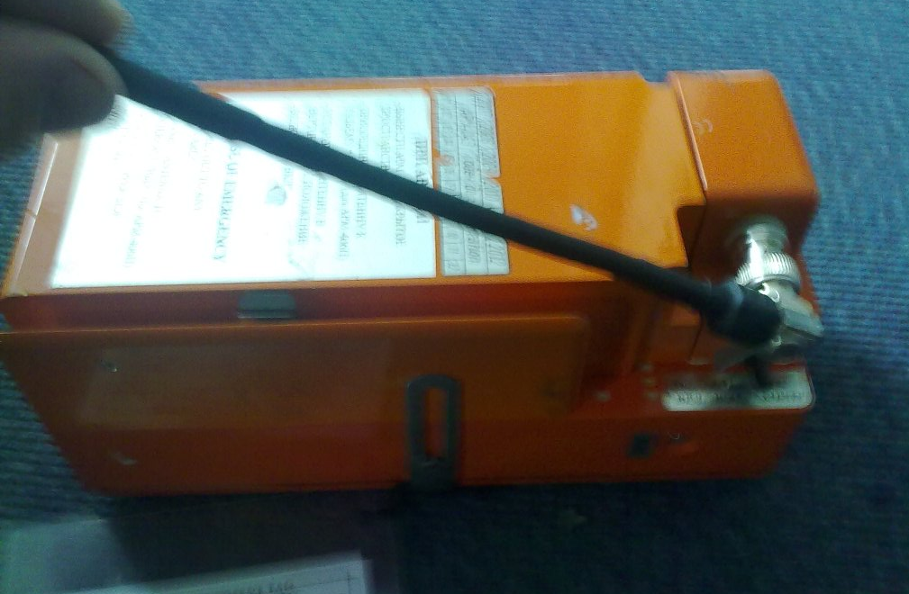
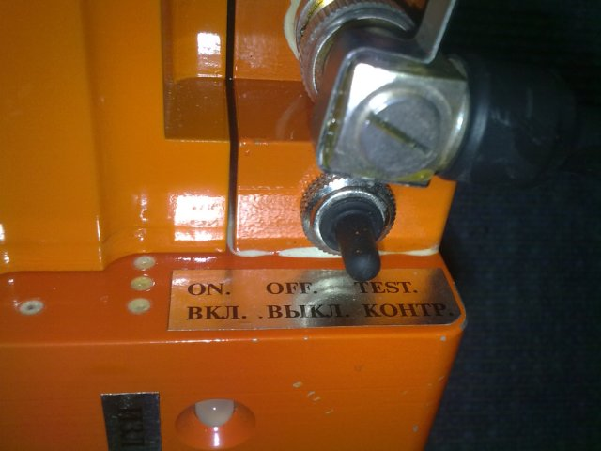
How to use:
For manual ELT activation:
unfasten metal or “Velcro” fastener and pull the devise out of its bracket;
take the beacon with you;
deploy antenna and turn the switch to «ВКЛ» position;
it transmits a 121.5 MHz and 406.025 MHz signal to facilitate the final approach of the search and rescue teams.
Слайд 20.
Notes:
Раздаточный слайд

Slide 15
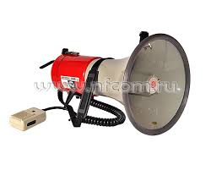
*Megaphone
Pre-flight check:
- available on board;
- secured;
press the button on the megaphone handle (or squeeze the handle on some models) to check the sound.
How to use:
Press the button on the handle (or squeeze the handle) and speak normally into the mouthpiece.
Слайд 21.
Notes:
Раздаточный слайд

Slide 16

FIRE TRIANGLE
*Fire and smoke
FUEL
OXYGEN
TEMPERA­TURE
Слайд 27.

Slide 17
REPORT
«MESSENGER» must use interphone (telephone) to prevent penetration of smoke and hazardous vapors into the flight deck
Never leave unattended the fire site. Provide continuous monitoring of possible repeated ignition, and never consider the fire to have ceased completely.

Slide 18
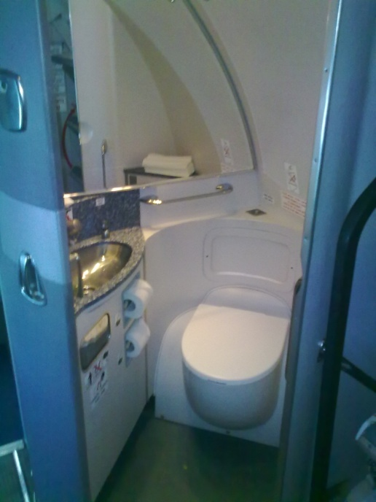
*Certain fire-hazardous points
Lavatories
Cabin crew members must inspect lavatories at regular intervals throughout a flight.
The interval for inspection must be 20 minutes.
Inspecting the lavatories, ensure that:
smoke detector sensor is free and unobstructed;
the door, behind which the stationary fire extinguisher and waste container are located, is closed tightly;
toilet paper, paper napkins and towels are secured;
toilet bowl lid must be closed;
uninterrupted washout in the toilet bowl is absent (if not, this must be reported to the Commander immediately).
Слайд 30.
Notes:
Раздаточний слайд

Slide 19
Oven fire
If you determined that the fire has occurred in an oven, you must:
de-energize the oven by pulling out the corresponding circuit breaker on the galley electrical control unit (if you fail to pull out the fuse on the galley electrical control unit, ask the Commander to disconnect the galley power supply from the flight deck);
leave the oven door closed so that the fire can die due to oxygen shortage.
If the conditions worsen and the fire becomes more severe:
take «HALON2 fire extinguisher, put on smoke hood;
carefully open the door to the extent that enables a nozzle of the fire extinguisher to be inserted, using the door as a protective shield;
pressing the lever 2 – 3 times at short intervals, spray the liquid inside the oven, moving the nozzle downward; close the oven door immediately;
monitor the situation; if necessary, carry out the fire-fighting procedures once more.
Слайд 34.

Slide 20
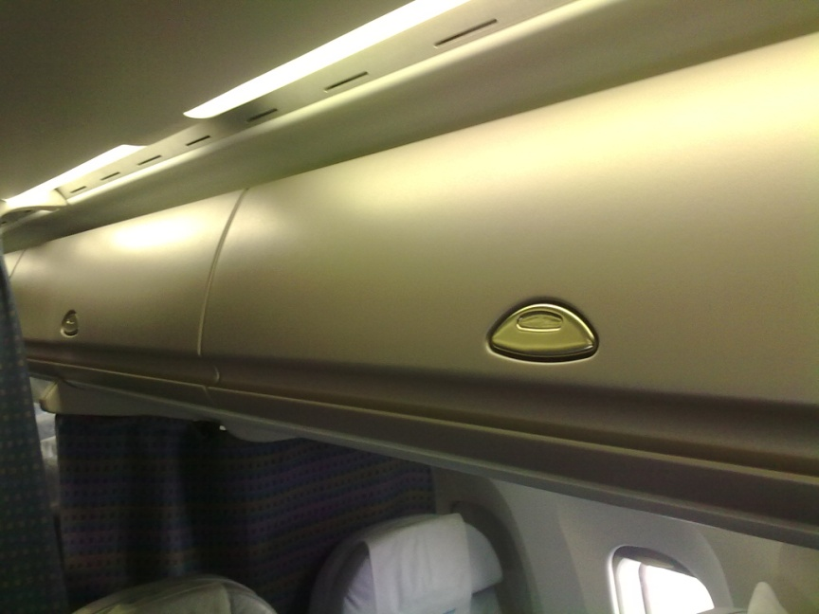
Luggage bins
If smoke goes from the luggage bins located over a row of passenger seats, you should proceed as follows:
make the passengers be seated far from the dangerous area
use «HALON» fire extinguisher
open the rack slightly and discharge the fire extinguisher directing the jet along the rack;
close the rack;
carry out the procedure again, if necessary.
Слайд 37.

Slide 21

*Fire outside the aircraft
If fire emerges on the ground or during the flight outside the aircraft, you should take the following steps:
report to the Commander thereupon
reassure the passengers and prevent panic
monitor the fire;
be ready to evacuate passengers, if necessary.
Слайд 39.
Notes:
Раздаточний слайд

